Slide 1

Implementation of Machine Learning model in Abaqus using VUMAT subroutine.
Presenter: Riddhi Shah, Xuan Binh
Code implementation: Riddhi Shah, Xuan Binh, Sayoojya Prasad
Supervisor: Junhe Lian
Department of Mechanical Engineering
Aalto University

Slide 2

Table of Contents
Motivations for ML-coupled Abaqus subroutine
Von Mises isotropic hardening model
Complete setup workflow
Step 1: Tensorflow C API
Step 2: Fortran subroutine preparation
Step 3: ml_module template
Step 4: Compiling and linking via abaqus_v6.env
Step 5: Updating Abaqus input file
Step 6: Integrating ml_module into Abaqus VUMAT
Step 7: VEXTERNALDB for pre/postprocessing
Results of ML-coupled VUMAT model

Slide 3
Motivations for ML-coupled Abaqus subroutine
Numerous studies on dynamic mechanical properties of materials
Constitutive laws, the relation between internal forces and deformations
Constitutive laws in some conditions they cannot fit well some complex behaviors of materials
Abaqus provides the ability to implement only the constitutive flow, or the complete constitutive behavior law via FORTRAN user subroutines: UMAT or VUMAT for the complete behavior law and UHARD or VUHARD for the hardening flow law
The major difference from VUMAT to UMAT is that VUMAT subroutines do not need the evaluation of the so-called consistent Jacobian matrix, but only the evaluation of the stress tensor σ1 at the end of the increment.

Slide 4
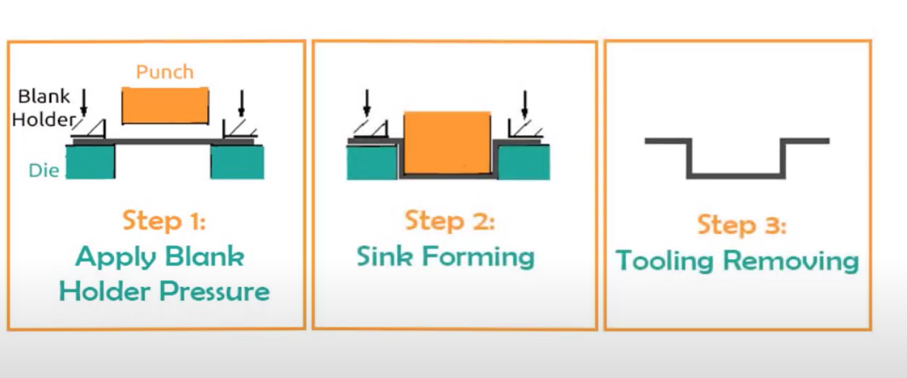
STEP

Slide 5
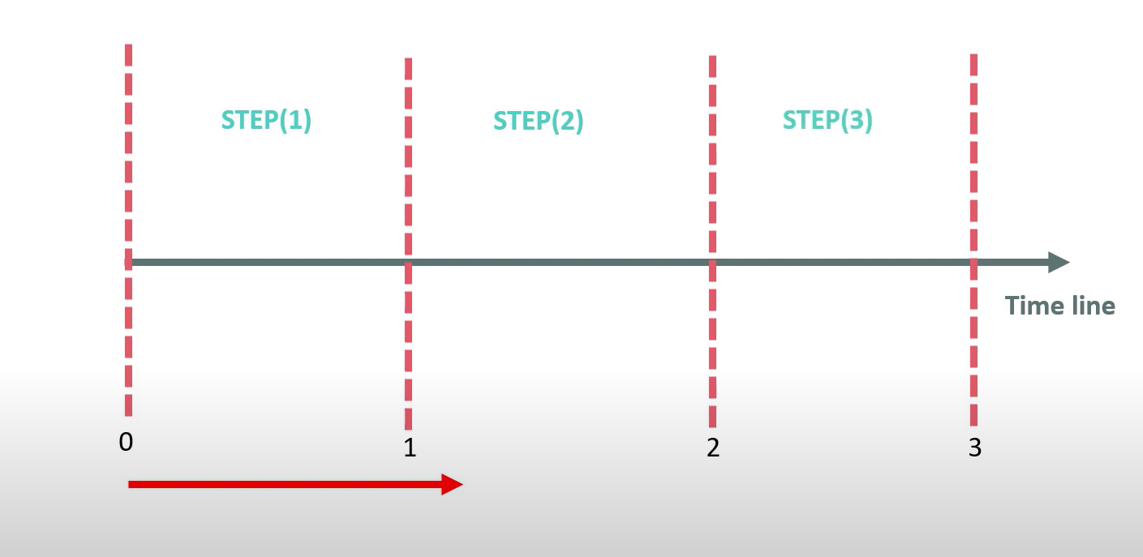
STEP

Slide 6
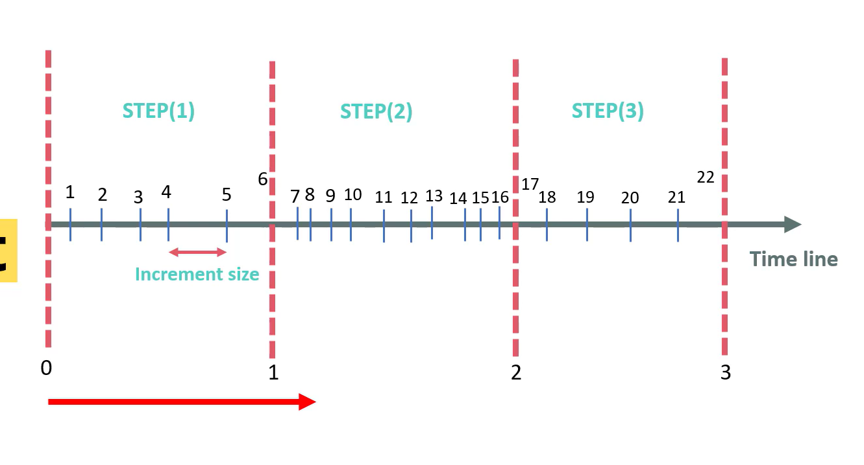
INCREMENT AND INCREMENT SIZE

Slide 7
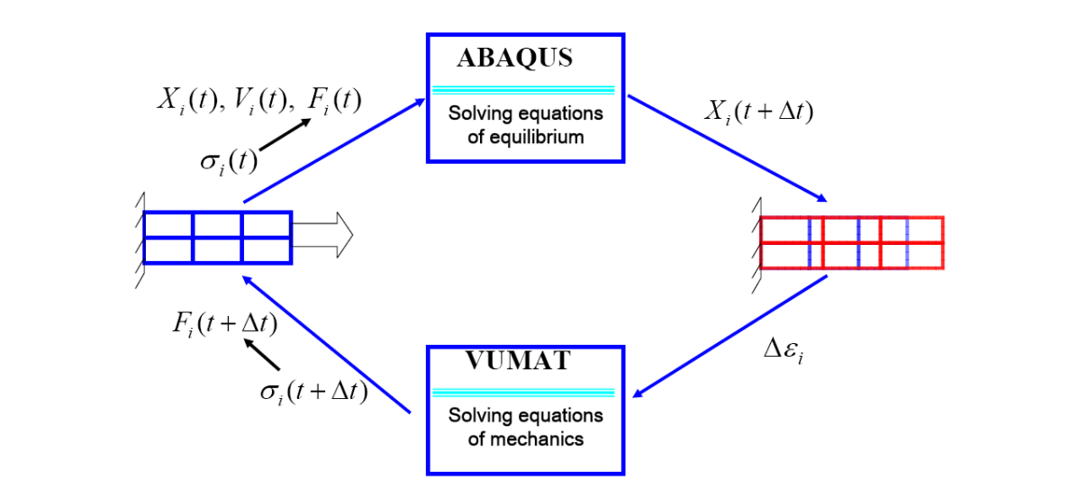
Where does VUMAT fit in Abaqus

Slide 8
Input and output of ML model
INPUTS
(1) strain (initial value: 2e-08, can be taken as 0.0)
(2) strain rate (initial value: 0.1)
(3) initial temperature (K) (initial value: 293 K)
OUTPUTS
(1) stress (MPa)
(2) delta temperature (K)
Machine Learning Model

Slide 9
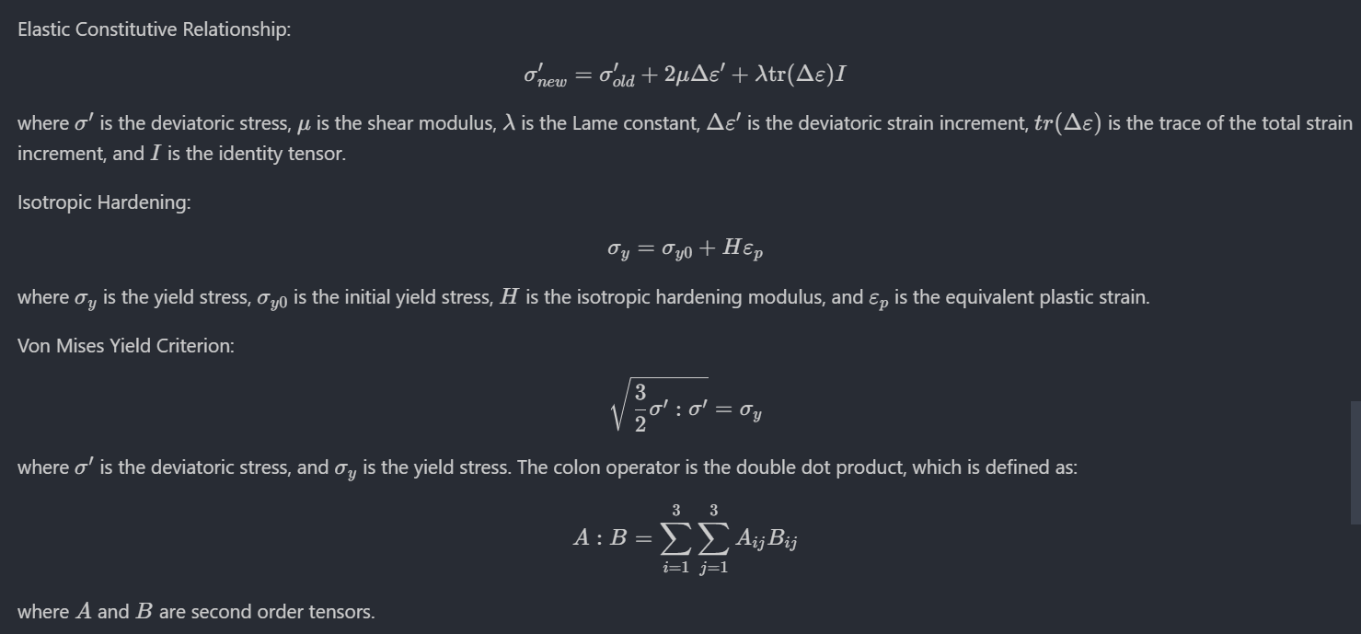
Abaqus VUMAT for von Mises isotropic hardening model

Slide 10
Abaqus VUMAT model
State dependent variables:
The number and type of State Dependent Variables (SDV) depends on the material model.
They are typically used to "remember" the state a material point is in between calls to the VUMAT.
Another use of state variables is to save other values that we are interested in.
We have 4 state dependent variables in this model: PEEQ, Strain Rate, Stress and Temperature
Matrices/values are being updated by each increment
stressOld: the stress tensor at increment n, stressNew is updated at increment n + 1
stateOld: the SDV values at increment n, statetNew is updated at increment n + 1
The same for internal energy and inelastic energy, which requires updating
However, some properties have both “old” and “new” provided for each increment already, such as temperature, stretch, defgrad and field. Also, PEEQ (strainInc) does not have New input.

Slide 11
General setup workflow for ML integration
Step 1: Download Tensorflow C API (c_api.h) and related libraries. Then, install fortran-tf-lib on CSC.
Step 2: Prepare Abaqus VUMAT subroutine dummy model (such as von-Mises stress model)
Step 3: Convert ML model to .pb format and use process_model to generate ml_module Fortran template
Step 4: Prepare environment file abaqus_v6.env for custom compilation and linkage
Step 5: Update Abaqus .inp file for the State dependent variables (SDV) and constants for the ML model
Step 6: Incorporate the ML model prediction into Fortran code using the ml_module and TF C API library
Step 7: Use VEXTERNALDB to ensure the ML model is initialized once and closed once for all VUMAT calls
Our whole project is located at this repository: https://github.com/SpringNuance/VUMAT-Abaqus-ML-Integration

Slide 12


Step 1: Downloading Tensorflow C API and install fortran-tf-lib

Slide 13

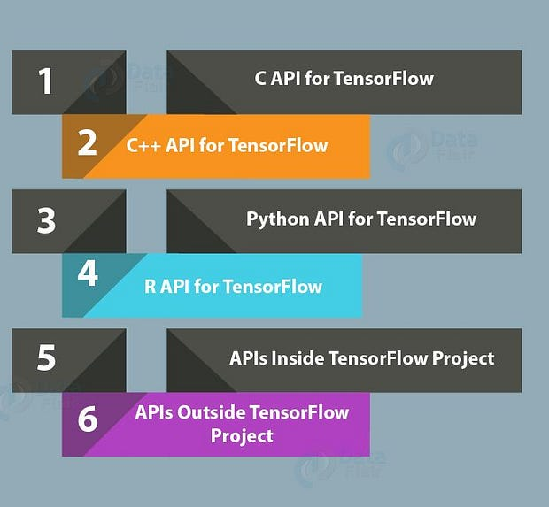
Tensorflow C API
The TensorFlow C API allows Tensorflow graph constructions and bindings for non-Python languages, including Fortran, and is defined in c_api.h, focusing on simplicity and uniformity​​.
Files like lite/c/c_api_types.h and lite/c/common.h are for defining types and common C types used in TensorFlow's inference, kernel,
and interpreter APIs
The TensorFlow C API is used where neural networks trained in Python is utilized within the Fortran code​​. This is because Fortran and Python have no native communication framework
There exists a library, fortran-tf-lib, which provides code and examples for directly calling TensorFlow ML models from Fortran, enabling integration of TensorFlow with Fortran
Link: https://www.tensorflow.org/install/lang_c
Docs: https://github.com/tensorflow/tensorflow/tree/master/tensorflow/c

Slide 14
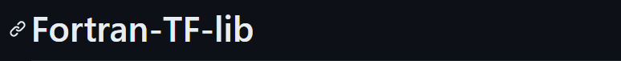


fortran-tf-lib github library
Two approaches to extract the ML inference from Fortran code.
1) Use Fortran C bindings as a bridge for communication between Fortran And Tensorflow (chosen method)
2) Expose Tensorflow model through API accessible from Fortran via an http-request library
Discussions: https://stackoverflow.com/questions/66107018/how-to-use-a-neural-network-pytorch-or-tensorflow-based-in-fortran
fortran-tf-lib is a library specifically designed for directly calling TensorFlow / Keras ML models from Fortran, providing a direct link between Fortran code and TensorFlow ML model. This abstracts away the Fortran C binding which should have been a manual process
- fortran-tf-lib repository: https://github.com/Cambridge-ICCS/fortran-tf-lib
To load ML model, the library requires that the caller knows certain opaque model parameters beforehand. To address this, the Python script process_model is provided, which reads a Keras SavedModel and output a simple Fortran module intended to provide a base for the user to start from
- process_model repository: https://github.com/Cambridge-ICCS/process_model

Slide 15
Bugs and debugging: which compiler gfortran / ifort / ifx for Fortran?
The answer is ifort, which is the classic Intel compiler for Fortran
Compiler gfortran is the open source compiler from GNU package. However, Abaqus do not use GNU for Fortran compilation, but instead using Intel compiler.
Latest Intel compiler for fortran, ifx, may not be compatible with the library fortran-tf.
=> Only ifort is compatible with both Abaqus and fortran-tf library.
The Tensorflow C API and fotran-tf compiling scripts:
https://github.com/SpringNuance/VUMAT-Abaqus-ML-Integration/tree/main/fortran_tf_installation/fortran-tf-lib
Compiling on Puhti: https://docs.csc.fi/computing/compiling-puhti/
module load intel-oneapi-compilers-classic
cmake .. -DCMAKE_BUILD_TYPE=Release \
-DCMAKE_Fortran_COMPILER=ifort \
-DCMAKE_C_COMPILER=icc \
-DTENSORFLOW_LOCATION=/projappl/project_2004956/fortran-tf-lib/tensorflow \
-DCMAKE_INSTALL_PREFIX=/projappl/project_2004956/fortran-tf-lib/tf_intel
Loading Intel classic compilers, including ifort, icc, icpc
Fortran-tf library requires both Fortran and C compilers
Path to TF installation
Installation prefix for libfortran-tf.so, TF_Types
and TF_Interface modules

Slide 16
Step 2: Abaqus
VUMAT for von Mises isotropic hardening

Slide 17
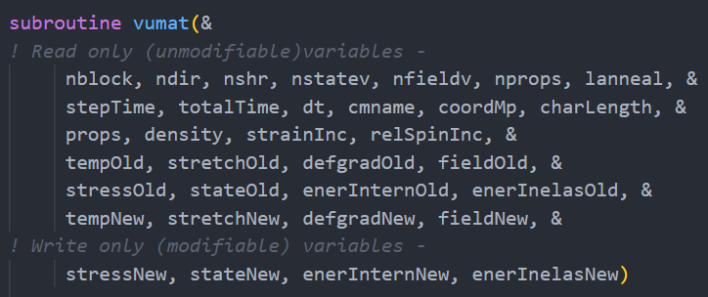
Analyze input arguments of VUMAT
We can see there are matrices that have “new” and “old” versions
stressOld: the stress tensor at increment n, stressNew is updated at increment n + 1
stateOld: the SDV values at increment n, statetNew is updated at increment n + 1
The same for internal energy and inelastic energy, which requires updating
However, some properties have both “old” and “new” provided for each increment already, such as temperature, stretch, defgrad and field. Also, PEEQ (strainInc) does not have New input.
dt: time increment is crucial for delta PEEQ
! For plane strain, axisymmetric, and 3D cases using
! the J2 Mises Plasticity with piecewise-linear isotropic hardening.
!
! The state variable is stored as:
!
! STATE(*,1) = PEEQ
! STATE(*,2) = strain rate
! STATE(*,3) = stress
! STATE(*,4) = temperature
!
! We don’t use the temperature provided by VUMAT: tempOld and tempNew
! but we use the temperature from the previous increment from SDV

Slide 18
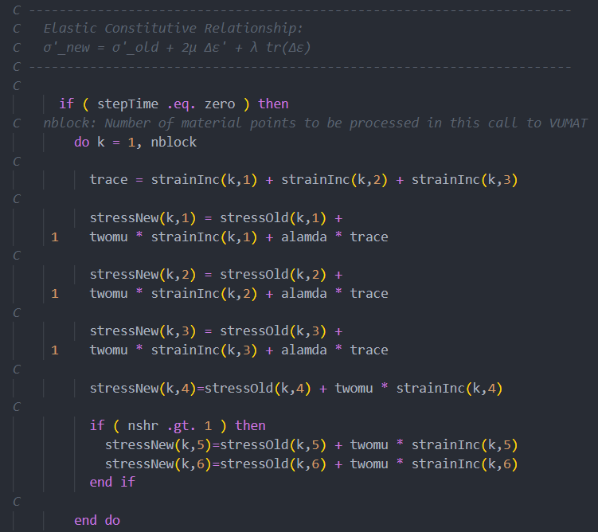
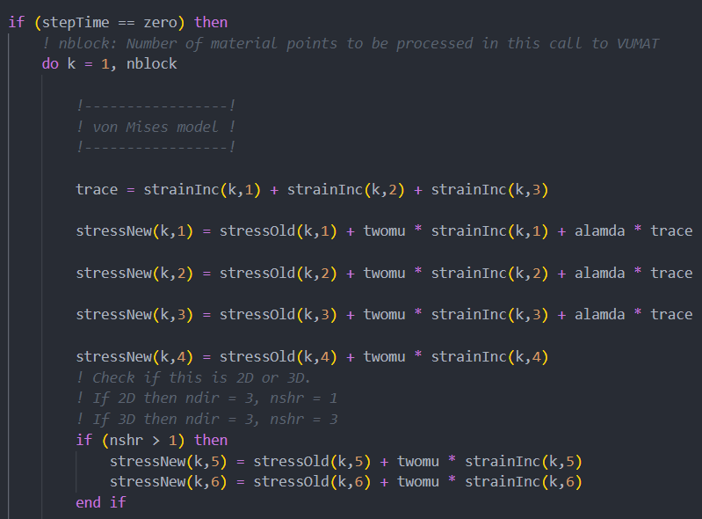
Abaqus VUMAT for von Mises isotropic hardening model
VUMAT Fortran v77
VUMAT Fortran v90

Slide 19
Fortran version 77 v.s version 90
When developing the subroutine, it is always preferable to choose later versions.
If template code is given in v77, it is better to convert it to v90
Abaqus fortran extension accepted by Abaqus: .f / .for / f90 / f95
As a rule of thumb, we should always use .f90 for VUMAT. This suffix means that the source code is free format, not that the code conforms to the Fortran 90 standard.
 | Version 77 (fixed format) | Version 90 (free format)
Comment style | 'C' or '*' in the first column | '!' anywhere in the line
Length of line | At most 72 characters | At most 132 characters
File extension | .f or .for | .f90 or .f95 and later
Column restriction | Comments are in column 1-5. Column 6 is line continuation symbol. Code starts from at least column 7 | No column restrictions at all
Newline style | Using * or 1-9 on column 6 at start of line code | Using ampersand & at the end of line code
Declare constants | PARAMETER (PI = 3.14159) | REAL, PARAMETER :: PI = 3.14159
IMPLICIT NONE | Not official in v77, which usually do not enforce strong type declaration | Official in v90, enforcing strong type (DO NOT USE IMPLICIT NONE FOR VUMAT !!)
Column Restrictions: In fixed format, code must adhere to specific column rules
- code must start at least from column 7 and comments are in column 1-5.
- column 6 is for line continuation symbol, marked by * or an integer 1-9
- each line is at most 72 columns. More code than that and we have to move to next line
Free format does not have such column restrictions. However, its line limit is 132 columns.
In free format, an ampersand & at the end of a line indicates continuation.
Comment Style: Fixed format uses a 'C' or '*' in the first column for comments. Free format uses '!' anywhere in the line for comments.
Length of Lines: Fixed format typically limits lines to 72 characters, while free format supports longer lines, typically up to 132 characters.
File Extensions: Traditionally, different file extensions are used (.f or .for for fixed format, .f90 or later like .f95, .f03 for free format).
Whitespace Sensitivity: Free format is less sensitive to whitespace compared to fixed format.

Slide 20
Step 3: ML
model conversion and ml_module template

Slide 21
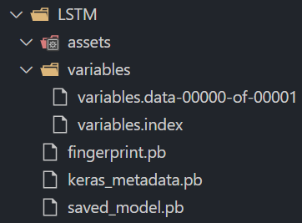

Converting from .h5 to .pb format in Tensorflow
The TensorFlow C API expects a frozen model in a .pb (protobuf) file, which contains the graph definition as well as the weights of the model in a binary format.
Converting an .h5 file to a .pb file makes the model accessible for the TensorFlow C API, which does not directly support the .h5 format.
An .h5 file used by Keras stores the model architecture and weights separately in a hierarchical format that's optimized for datasets that contain large arrays of data.
import tensorflow as tf
model = tf.keras.models.load_model('LSTM.h5')
model.save("LSTM", save_format='tf')
Note: YOU MUST NOT CHANGE ANYTHING UNDER THIS FOLDER, EVEN THE NAME OF THE MODEL. TENSORFLOW C API & process_model python EXPECTS THE NAME saved_model.pb

Slide 22

Generate Fortran ml_module template
To load the ML model, the library requires that the caller knows certain rather opaque model parameters beforehand. Often, the values in the example above will work for the tags parameter to TF_LoadSessionFromSavedModel. However, the values needed for TF_GraphOperationByName (such as serving_default_input_1, etc) are more likely to be different.
To address this, the library provides a Python script, process_model that will read a Keras SavedModel and output a simple Fortran module intended to provide a base for the user to start from. The appropriate values will be read from the model and hard-coded into the Fortran code.
It is better to do this on local computer than on CSC as “process_model” is automatically added to PATH on local
First, we install the process_model from github
$ pip install git+https://github.com/Cambridge-ICCS/process_model.git
Then, use process_model to generate the ml_module.f90 template from LSTM folder that contains saved_model.pb
$ process_model -o ml_module.f90 LSTM
You can ignore the warnings produced by the process

Slide 23
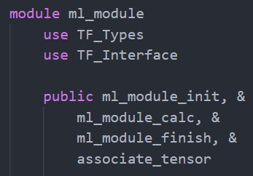
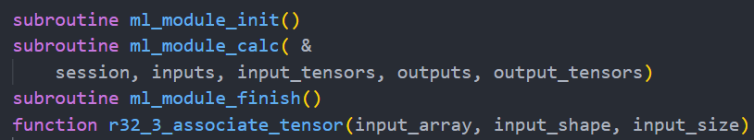
Fortran ml_module template
The output is a module, named ml_module by default. It has procedures called ml_module_init, ml_module_calc and ml_module_finish.
It also have some *_associate_tensor routines tailored for the inputs of the model. So if the model expects a Tensor of type TF_FLOAT and of shape [-1, 40] then there will be a r32_2_associate_tensor routine to generate appropriately shaped and typed tensors from Fortran arrays.
For example, the LSTM expects the input of shape (batch size, time step, 3), so the function is a r32_2_associate_tensor
The ml_module_init routine is called once before Explicit analysis. It loads the models into module variables.
The ml_module_calc is called frequently for ML inference
The ml_module_clean is called once after analysis completion

Slide 24
Step 4: Custom
Abaqus Fortran compiling and linking

Slide 25
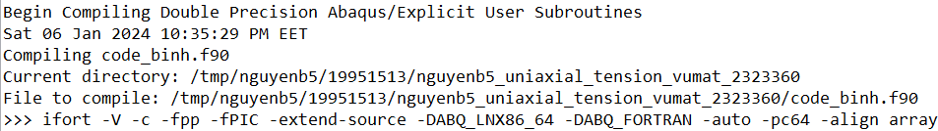
Order of Abaqus Explicit execution
Step 1: Preparing MPI setup and running
DriverLM command
Step 2: Compiling Single/Double Precision Abaqus/Explicit User Subroutines
Step 3: Linking Single/Double Precision Abaqus/Explicit User Subroutines
Step 4: Begin Analysis Input File Processor
Step 5: Begin Abaqus/Explicit Packager. This stage is invoked before the start of analysis, which runs the VUMAT at stepTime = 0 for all integration points
Step 6: Begin Abaqus/Explicit Analysis, where VUMAT runs from increment 1 onwards. VEXTERNALDB is called once here at the start of analysis
Step 7: Abaqus/Explicit Analysis finishes. VEXTERNALDB is called once here
at the end of the analysis

Slide 26
Fortran compiling environment in Abaqus: abaqus_v6.env
compile_fortran = [
'ifort',
'-V', '-c', '-fpp', '-fPIC', '-extend-source',
'-DABQ_LNX86_64', '-DABQ_FORTRAN',
'-auto', '-pc64', '-align', 'array64byte',
'-prec-div', '-prec-sqrt', '-fp-model', 'precise',
'-fimf-arch-consistency=true',
'-mP2OPT_hpo_vec_divbyzero=F', '-no-fma',
'-fp-speculation=safe', '-fprotect-parens',
'-fstack-protector-strong', '-reentrancy', 'threaded',
'-msse3', '-axcore-avx2,avx', '-WB',
'-I.',
'-DDPX',
'-I/appl/soft/eng/simulia/EstProducts/2023',
'-I/appl/soft/eng/simulia/EstProducts/2023/linux_a64/code/include',
'-I/appl/soft/eng/simulia/EstProducts/2023/linux_a64/../SMAUsubs/PublicInterfaces',
'-I/appl/soft/eng/simulia/EstProducts/2023/linux_a64/code/bin/SMAExternal/pmpi/include',
'-I/projappl/project_2004956/fortran-tf-lib/fortran-tf-lib/tf_intel/include/fortran-tf',
'-I/scratch/project_2004956/test_VUMAT_ML',
]
First, we create a file “abaqus_v6.env” in the current simulation directory. Then we fill in two Python format lists, one called compile_fortran and another link_sl
Abaqus would respect this Fortran compilation settings, enabling us to add TF_Types, TF_Interface and Tensorflow C API Library
Green: default compiling flags
Red: -I include flags to make the compiler aware of tf-types, tf-interface and ml_module.mod
What is abaqus_v6.env: https://docs.software.vt.edu/abaqusv2022/English/SIMACAEILGRefMap/simailg-m-EnvUsing-sb.htm
How to link gfortran to Abaqus (xizou.github.io) https://xizou.github.io/2017/07/26/link-gfortran-to-abaqus/

Slide 27
Fortran linking environment in Abaqus: abaqus_v6.env
link_sl = [
'ifort',
'-V', '-cxxlib', '-fPIC', '-threads', '-shared', '-Wl,--add-needed',
'-Wl,-u,vcosimulation_', '-Wl,-u,vcosimulation0_', '-Wl,-u,vdflux_',
'-Wl,-u,vdisp_', '-Wl,-u,vdload_', '-Wl,-u,vexternaldb_', '-Wl,-u,vfabric_',
'-Wl,-u,vfric_', '-Wl,-u,vfric_coef_', '-Wl,-u,vfriction_', '-Wl,-u,vhetval_',
'-Wl,-u,vsdvini_', '-Wl,-u,vuamp_', '-Wl,-u,vuanisohyper_inv_',
'-Wl,-u,vuanisohyper_strain_', '-Wl,-u,vucharlength_', '-Wl,-u,vucreepnetwork_',
'-Wl,-u,vuel_', '-Wl,-u,vueos_', '-Wl,-u,vueulgenprop_', '-Wl,-u,vuexpan_',
'-Wl,-u,vufield_', '-Wl,-u,vufluidexch_', '-Wl,-u,vufluidexcheffarea_',
'-Wl,-u,vugens_', '-Wl,-u,vuhard_', '-Wl,-u,vuinflprop_', '-Wl,-u,vuinter_',
'-Wl,-u,vuinter_cza_', '-Wl,-u,vuinteraction_', '-Wl,-u,vumat_', '-Wl,-u,vumatht_',
'-Wl,-u,vumullins_', '-Wl,-u,vuporepress_', '-Wl,-u,vusdfld_', '-Wl,-u,vusdfld_cza_',
'-Wl,-u,vusuperelashardmod_', '-Wl,-u,vusuperelasplastmod_', '-Wl,-u,vutrs_',
'-Wl,-u,vutrsnetwork_', '-Wl,-u,vuviscosity_', '-Wl,-u,vwave_',
'-Wl,-u,_Z19SMAUXpU_XP_finalizeRi', '-Wl,-u,_Z21SMAUXpU_XP_initializeRi',
'-Wl,-u,_Z23SMAUXpUsubs_XP_finalizeRi', '-Wl,-u,_Z25SMAUXpUsubs_XP_initializeRi',
'-Wl,-u,_Z32SMAUXpUsubs_XP_specific_finalizeRi', '-Wl,-u,_Z34SMAUXpUsubs_XP_specific_initializeRi',
'-Wl,-u,xplu_callallutils_', '-Wl,-soname,libexplicitU-D.so’,
'-L/projappl/project_2004956/fortran-tf-lib/fortran-tf-lib/tf_intel/lib64’,
'-lfortran-tf',
'/scratch/project_2004956/test_VUMAT_ML_final/ml_module.o',
'-o', 'libexplicitU-D.so’, 'code_binh.o',
]
Green: default linking flags
Red: -L and –l linking statements to the shared library
libfortran-tf.so.
It also links the compiled object file of user subroutine (code_binh.o) and ml_module.o
The output is the shared library libexplicitU-D.so
How to link gfortran to Abaqus (xizou.github.io) https://xizou.github.io/2017/07/26/link-gfortran-to-abaqus/

Slide 28
Bugs and debugging: Symbol lookup error
If you saw an error of symbol lookup error like this one
/appl/soft/eng/simulia/EstProducts/2023/linux_a64/code/bin/explicit_dp: symbol lookup error: /tmp/nguyenb5/19956223/nguyenb5_uniaxial_tension_vumat_1260341/libexplicitU-D.so: undefined symbol: tf_interface_mp_tf_newgraph_
It is most likely that a library is missing or not linked yet in linking stage, or some modules have not been added during compiling stage.
If you are missing out on .mod files, you must add –I<path to mod files> flag to compile_fortran list
If you have not linked the required libraries, you must add –L<path to library file> flag, then followed by
-l<library name> flag to link_sl list. You must be sure that all shared library names start with ”lib”
Note: the library name in linking –l flag does not have the initial ”lib” and file extension ”.so” or ”.a” included
For example: library ”libfortran-tf.so” would be linked as ”-lfortran-tf”
You can use command $ ldd to see dependencies of .so libraries to ensure that there is no missing linkings.

Slide 29
Step 5:
Updating Abaqus .inp for
ML model integration

Slide 30
Updates in Abaqus .inp file for SDV and Constants for VUMAT
To incorporate the ML model into the VUMAT, we must know the processing of input and output of the LSTM
### Input
(1) strain (initial value: 2e-08, can be taken as 0.0)
(2) strain rate (initial value: 0.1)
(3) initial temperature (K) (initial value: 293 K)
The shape of input: (batch size, time step, 3), where last dimension is [strain, strain rate, initial temprature]
### Output
(1) stress (MPa)
(2) delta temperature (K)
The shape of output: (batch size, time step, 2), where last dimension is [stress, delta temperature]
Input to the model is log10(strain) and log10(strain rate), temperature, then normalized to [0, 1]
Output from the model is normalized stress and delta temp in [0, 1], we must denormalize them to feed to stateNew(k, i)
We must have the upper and lower end for each variable. In total we have 2 x 5 = 10 constants, in addition to
4 material constants: E, Poisson’s ratio, initial yield stress and Hardening modulus

Slide 31
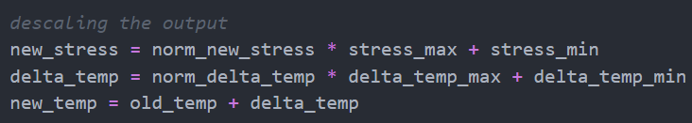
How are inputs to ML model updated in the next increment?
Suppose we have PEEQ_n, strain rate_n and temperature_n at increment n
The updated PEEQ is derived from the von Mises model, current delta_PEEQ_n added to PEEQ_n
The updated strain rate_n+1 is equal to delta_PEEQ_n/increment time
The updated temperature is evolved from the output of LSTM
temperature_n+1 = temperature_n + delta temperature_n
However, the original LSTM model of Sayoojya did not work like this. The initial temperature and strain rate stays constant throughout the increment update, only the PEEQ is updated as the input

Slide 32
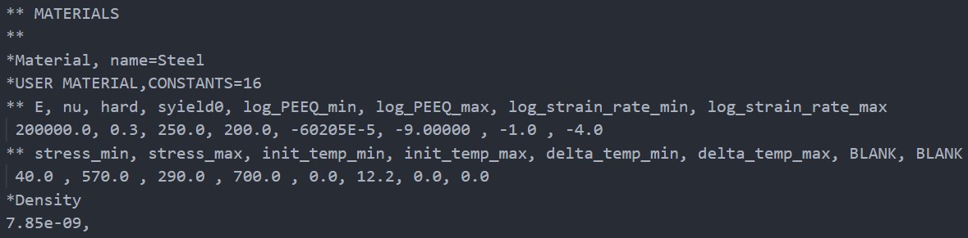
Bugs and debugging: input constants
Comments are marked by two asterisks **, and section part of Abaqus is marked by one asterisk * in .inp file
When declaring constants in .inp file, the number of constants is better to be divisible by 8 (optional)
Each row contains 8 constants, separated by a comma. There is no comma at the end of each line
If the number of constants is not divisible by 8, the rest values is filled with dummy 0.0 values
It is good practice to use comment ** for denoting parameter names for the constants
Constants only accept numbers of up to 1 decimal point. If you have more than 1 decimal point, you have to use exponent notation, otherwise Abaqus would extract as 0.0. Example: write -60205E-5 instead of -0.60205
Example: We have 14 constants, and we fill in 2 dummy values to make it to 16 constants

Slide 33
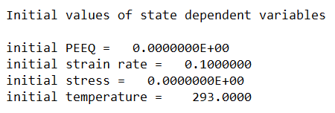
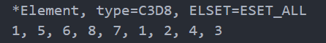
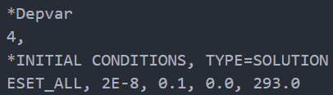
Bugs and debugging: DEPVAR and initial conditions of SDV
1st line: Element number/element set label <first SDV> <second SDV> …. <seventh SDV>
Naturally, you would use exponent notation if you have more than 1 decimal points
Subsequent lines (only needed if more than eight SDVs exist in the model)
It may be necessary to leave blank data lines for some elements if any other element in the model has more SDVs. These trailing initial values will be 0.0. Values on the data lines will be applied uniformly over the element.
Repeat this set of data lines as often as necessary to define initial values of SDVs
for various elements or element sets.
In this case, when stepTime = 0, we have
stateOld(k,1) = 0.0
stateOld(k, 2) = 0.1
stateOld(k, 3) = 0.0
stateOld(k, 4) = 293

Slide 34
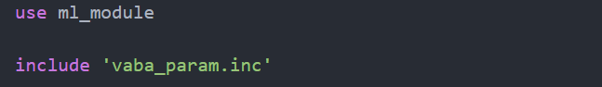
Bugs and debugging: do not declare type for Abaqus subroutine arguments
Abaqus use implicit declaration of variable type in FORTRAN subroutines. All variables for letters a-h, o-z is real and i-n are integers. This declaration is controlled with "include vaba_param.inc" statement.
You will not find this file but in your installation directory you will find files:
- vaba_param_sp.inc
- vaba_param_dp.inc
Now when you run an analysis with single precision Abaqus will use *_sp.inc file and when you run Abaqus with option "double“, *_dp.inc file will be used.
You MUST NEVER change declaration of variables passed with subroutine.
We control the precision by passing the flags “double=both/off output_precision=single/full” to Abaqus/Explicit
If you explicitly declare type for VUMAT arguments, it will result in undefined behavior with memory overriding due to different data type, producing random number such as for nprops, props, and nstatev, etc
Example: in v90, you should declare the VUMAT arguments as follows
dimension props(nprops) in stead of real, dimension(nprops) :: props (causing memory overflow)
VUMAT Double Precision discussion: https://www.eng-tips.com/viewthread.cfm?qid=373104

Slide 35
Step 6:
Incorporate ml_module
into Abaqus VUMAT

Slide 36
Incorporate ml_module interface into Fortran code
! Update PEEQ new (common to both vM and ML model)
new_PEEQ = old_PEEQ + delta_PEEQ
stateNew(k,1) = new_PEEQ
! Update strain rate
new_strain_rate = delta_PEEQ / dt
stateNew(k,2) = new_strain_rate
! Get old temperature
old_temp = stateOld(k,4)
! Transform and normalize inputs for ML model
log_new_PEEQ = log10(new_PEEQ)
log_new_strain_rate = log10(new_strain_rate)
norm_PEEQ = (log_new_PEEQ - log_PEEQ_min) / log_PEEQ_max
norm_strain_rate = (log_new_strain_rate - log_strain_rate_min) / log_strain_rate_max
norm_temp = (old_temp - temp_min) / temp_max
! Fill input_array with the the normalized values
input_array = reshape([norm_PEEQ, norm_strain_rate, norm_temp], [3, 1, 1])
! Define the shape of the input tensor
input_shape = [3, 1, 1]
output_shape = [2, 1, 1]

Slide 37
Incorporate ml_module interface into Fortran code
! Place the single tensor into an array
input_tensors(1) = r32_3_associate_tensor(input_array, input_shape)
! Call the ML inference
call ml_module_calc(model_session_1, inputs_1, input_tensors, outputs_1, output_tensors)
! Binding the pointers to the output to extract results
call c_f_pointer(TF_TensorData(output_tensors(1)), output_data_ptr, shape(output_data_ptr))
! Extracting the output from the pointer
norm_new_stress = output_data_ptr(1)
norm_delta_temp = output_data_ptr(2)
! output is normalized stress and delta temperature
! Descaling the output
new_stress = norm_new_stress * stress_max + stress_min
delta_temp = norm_delta_temp * delta_temp_max + delta_temp_min
new_temp = old_temp + delta_temp
! Update stress from ML output
stateNew(k,3) = new_stress
! Update temperature from ML output
stateNew(k,4) = new_temp

Slide 38
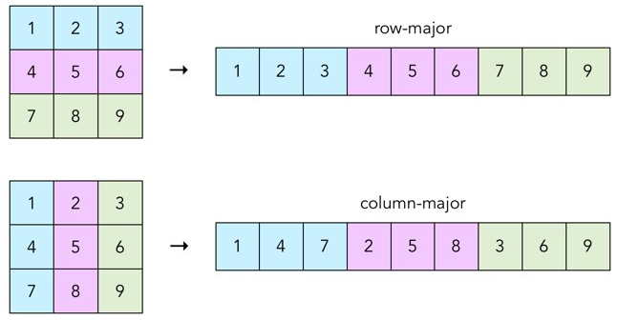
Bugs and debugging: Transposing matrix from Fortran to C API
In Fortran, arrays are stored in column-major order. This means that elements in a column are stored in contiguous memory locations. In other words, Fortran stores all elements of the first column, then all elements of the second column, and so on. This principal expands to higher dimensions as well
=> Memory access pattern: accessing an entire row in a column-major order array can be slower compared to accessing a column. This is because when accessing a row, the program has to jump across memory locations to collect each element from different columns => Accessing row A(:, 1) is slower than column A(1, :)
Fortran however has the same indexing order as Python Numpy/MATLAB.
To ensure compatibility with TF_Tensor input, which is row-major, the input to ML model must be transposed when it was in native Fortran array, so that the rows become contiguous in TF
Example: TF_Tensor input needs shape (1, 1, 3), so native Fortran should have shape (3, 1, 1)

Slide 39
Step 7:
User subroutine VEXTERNALDB

Slide 40
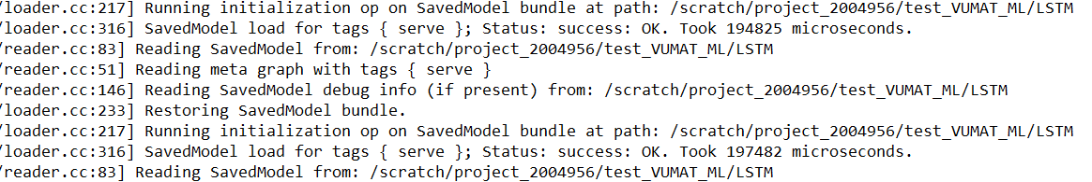
The time problem with ML model in VUMAT
If we simply incorporate the ML model into VUMAT, where it constructs the graph, making inference, then close the graph, what could possibly happen?
Consideration: we need to calculate how many times the VUMAT subroutine is invoked in the simulation
The number of increments in Abaqus Explicit is automatically determined during step 5: Begin Abaqus/Explicit Packager (check Slide Abaqus Execution Order). The number of increments is 20000 each frame, and we have 100 frames. Furthermore, the model has 8 nodes, and Abaqus domain level parallelism cannot divide further the 8 nodes, so the number of VUMAT calls is: 20000 x 100 x 8 = 16 million times, sequentially
From output file, the graph construction alone takes on average 0.19 second. Let’s say the inference tasks 0.01 second, then each call takes 0.2 second.
=> On the simplest cube of 1 element, 8 nodes, it would take 37 days to finish simulation

Slide 41

Bugs and Debugging: modules in Fortran follow the Singleton pattern!
The singleton pattern, in software design pattern, ensures that a class has only one instance, and to provide a global point of access to it. Fortran's modules are, by definition, an implementation of the singleton pattern
Example: database tables, ML model, process that broadcasts information in MPI.
You can read all design patterns here: https://refactoring.guru/design-patterns
We would want that the ML model is initialized and cleaned only once for each task (the same requirement for all tasks is not necesary as the overhead is very little).
When we link ml_module.o in link_sl, we have already ensured that TF_Graph and TF_Outputs, etc, are global variables that are accessible by all subroutines
When they are initialized, all subroutines can use the ML model. Unfortunately, VUMAT is called repeatedly. Is there a solution to this one time initialization and clean up?
Yes! The answer is VEXTERNALDB srt for Explicit Analysis. Standard equivalent is UEXTERNALDB
TF_Graph
TF_Outputs
VUMAT calls

Slide 42
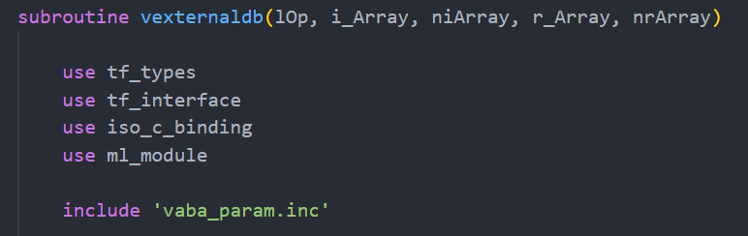
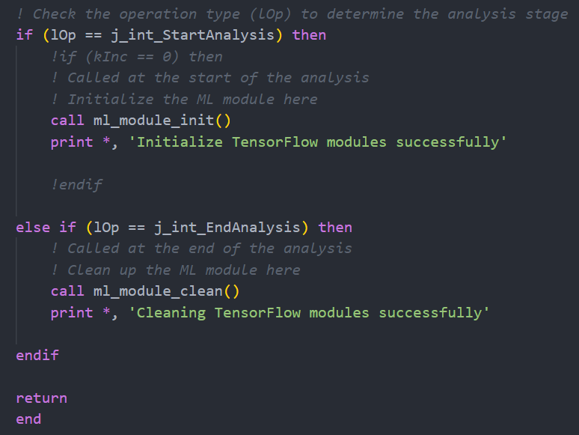
VEXTERNALDB subroutine
VEXTERNALDB can be used for many external program communications. They can be customized to be called
once at the start of the analysis (j_int_StartAnalysis)
at the start of each step (j_int_StartStep)
before each increment (j_int_SetupIncrement)
at the start of each increment (j_int_StartIncrement)
at the end of each increment (j_int_EndIncrement)
at the end of each step (j_int_EndStep)
once at the end of the analysis (j_int_EndAnalysis)
Thanks to the singleton pattern, ML graph and outputs initialized by VEXTERNALDB is accessible by VUMAT srt
Q: How to incorporate this srt with VUMAT?
A: simply put them in the same Fortran file of VUMAT. Abaqus automatically detect all available subroutines
Documentations on VEXTERNALDB (requires login)
https://help.3ds.com/2020/english/dssimulia_established/SIMACAESUBRefMap/simasub-c-vexternaldb.htm?contextscope=all&id=ad7ae7521f094a50b3e2dc9075aebe06

Slide 43
Results of ML-coupled VUMAT model

Slide 44
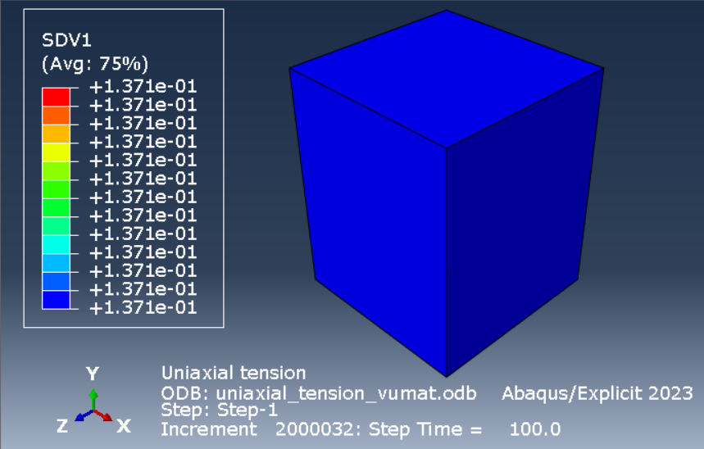
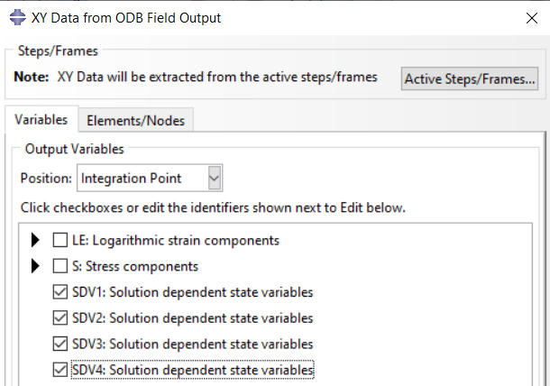
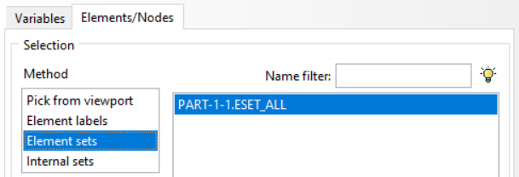
Extracting results
Number of frames: 100
SDV1: PEEQ
SDV2: strain rate
SDV3: stress
SDV4: temperature
Values extracted at 8 integration points,
then averaged out

Slide 45
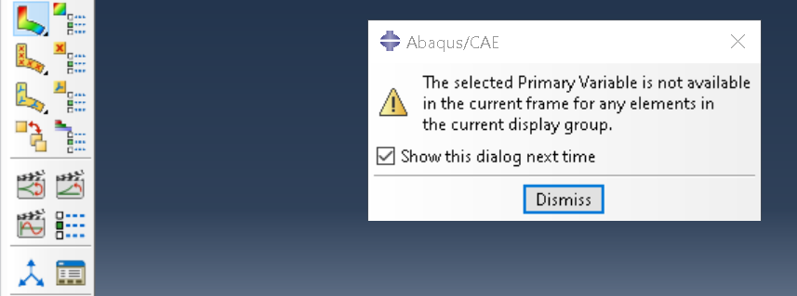
Bugs and debugging: selected Primary Variable not available
If you encounter this error when extracting results from .odb file
It most likely means that the result written to the stateNew(:, k) is NaN or Infinity, or any other fields that requires updating like stressNew
Solution: print out all variables to make sure none are undefined. When you do not initialize the variable, it would contain any arbitrary value, including Infinity.
Or, you need to ensure the updating progress do not explode in magnitude leading to (+/-) Infinity
Some discussions
https://www.reddit.com/r/fea/comments/p83tym/abaqus_keeps_showing_the_below_error_when_i_try/
https://www.researchgate.net/post/How-can-I-solve-this-error-the-selected-primary-variable-is-not-available-in-the-current-frame-step

Slide 46
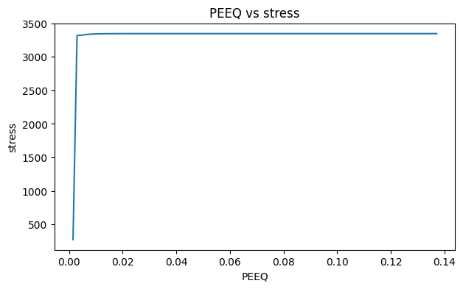
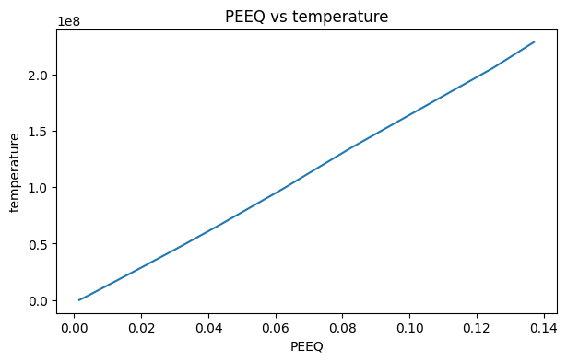
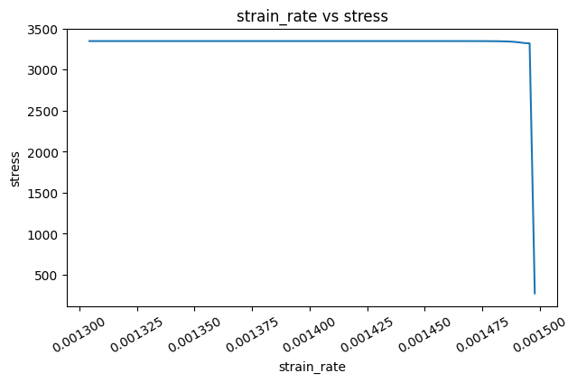
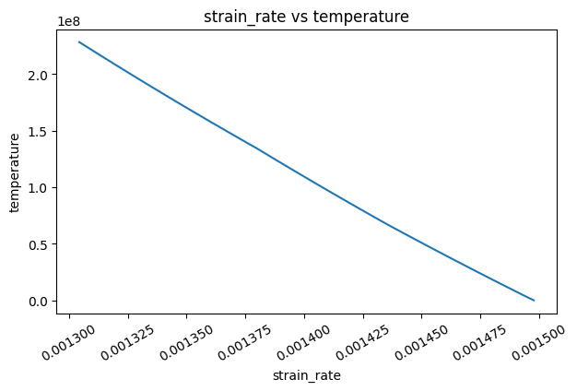
Result plots
The results at this stage is meaningless. We only try to ensure that the ML model incorporation works. For the ML model results to be meaningful, a better ML model should be trained with respect to different strain rate and temperature evolution

Slide 47
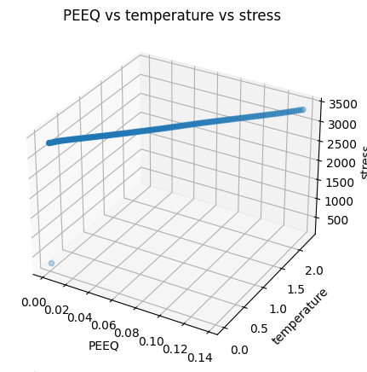
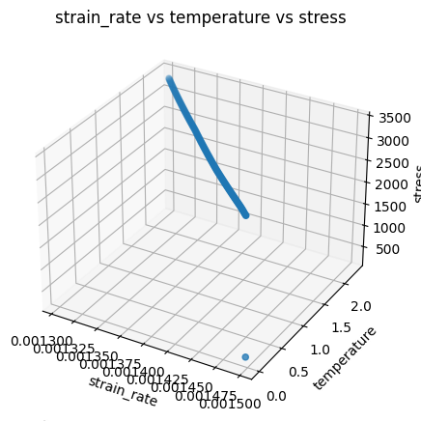
Result plots

Slide 48
Upcoming tasks
for faster ML
inference

Slide 49
Scaling up ML inference speed
Even if VEXTERNALDB has saved the overhead of graph construction, the inference passed to the LSTM is
still too slow. It takes roughly 4 hours to finish simulation for the simple cube model.
How to scale up computation when the model has 100000 nodes instead of only 8 nodes?
Things to consider:
Partitioning the FEM model to make use of domain parallelization. If we have 40 tasks and can utilize all of them, the running time is reduced by 40 times at most.
As we use Abaqus Explicit, we increase the increment size by choosing fixed mass scaling to a big number. After all, the ML model is used for deriving SDV, so stability in analytic solution is not necessary.
Reduce the mesh size to reduce the number of integration points
Decrease the time step to a small number so simulation runs faster
Use MPI communication to utilize more than one node on CSC, which can extends to more than 200 tasks. However, ensuring efficient CPU usage would be a complex process
Switch to Pytorch model, which supports GPU calculation in C API

Slide 50
My Learnings
Understanding of von Mises Model
A few things about machine learning techniques
Abaqus Software and Subroutines UMAT, VUMAT
Integration of different languages and software - Python and Fortran and Abaqus
Learnt more about coding and debugging
Collaboration and team work

Slide 51


THANK YOU FOR YOUR ATTENTION!

